Slide 1
Resume Classification Group-6
Mentors: Karthik and Dhanya
4/3/2023

Slide 2
Team Members:
Mr. Rohith S
Mr. Akshay N R
Mr. Tharunesh Mahendiran
Mr. S. Dharshan Kumaar
Mr. Mohammed Saquib Ayubi

Slide 3
Business Objective:
The business objective of Resume Classification is to help the organization to save time and resources in sorting resumes by job role , by our model it will save much of time per day for The Human Resources Department.

Slide 4
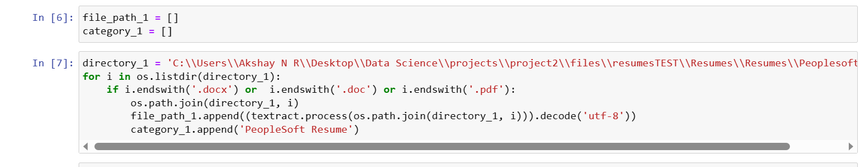
Extraction process:
First we converted resumes in pdf format to docx format.
We used python library textract to extract text data from the converted resumes.

Slide 5
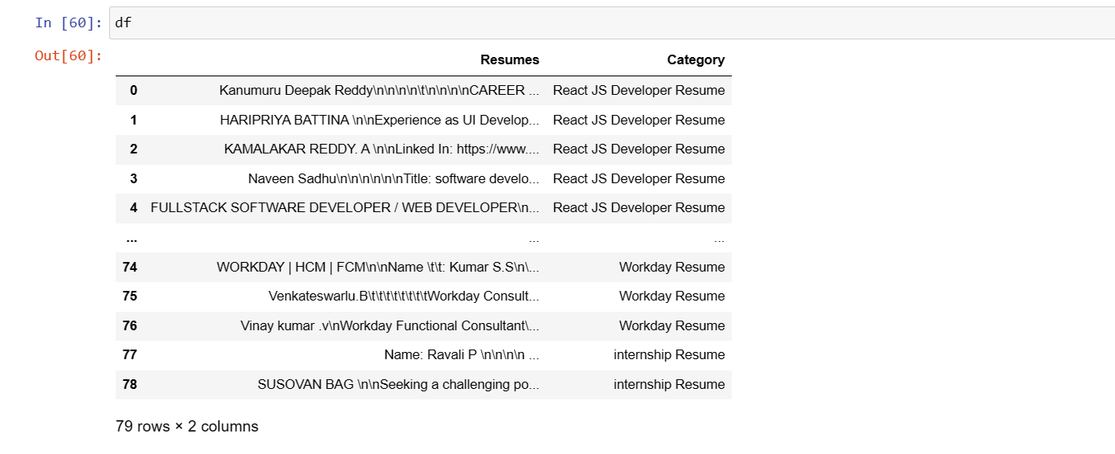
Then we converted the each category to a data frame and concatenated to a single data frame.

Slide 6
DATA PREPROCESSING
EDA AND VISUALIZATIONS
1.Transforming all the texts into lower case .
2.Removing the numericals,url’s,special characters,mentions.
3.Tokenization,lemmatization.
4.Checking the word frequency and removing the stop words.

Slide 7
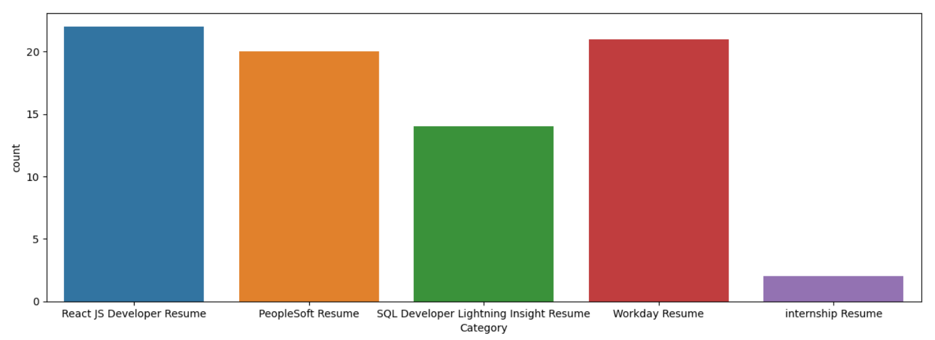
CATEGORYWISE COUNT PLOT

Slide 8
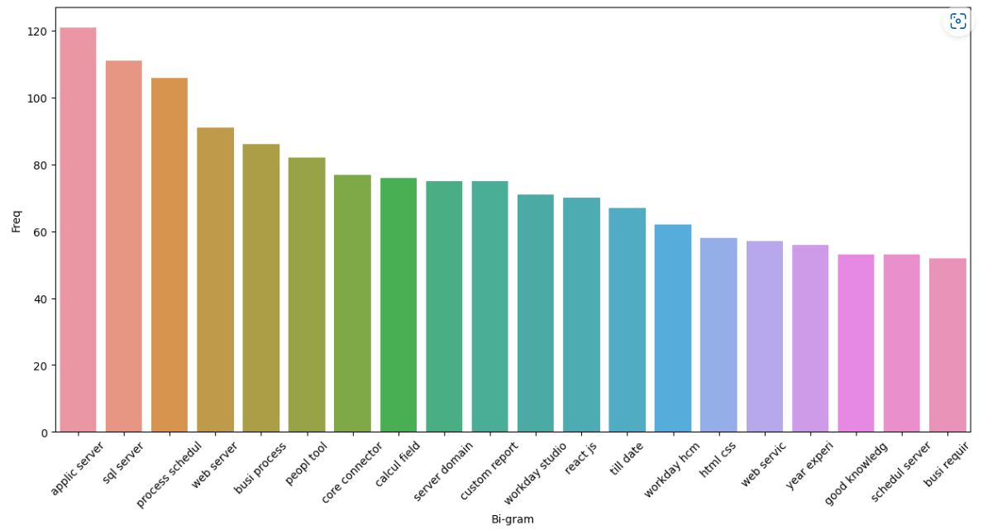
BIGRAM WORD FREQUENCY

Slide 9
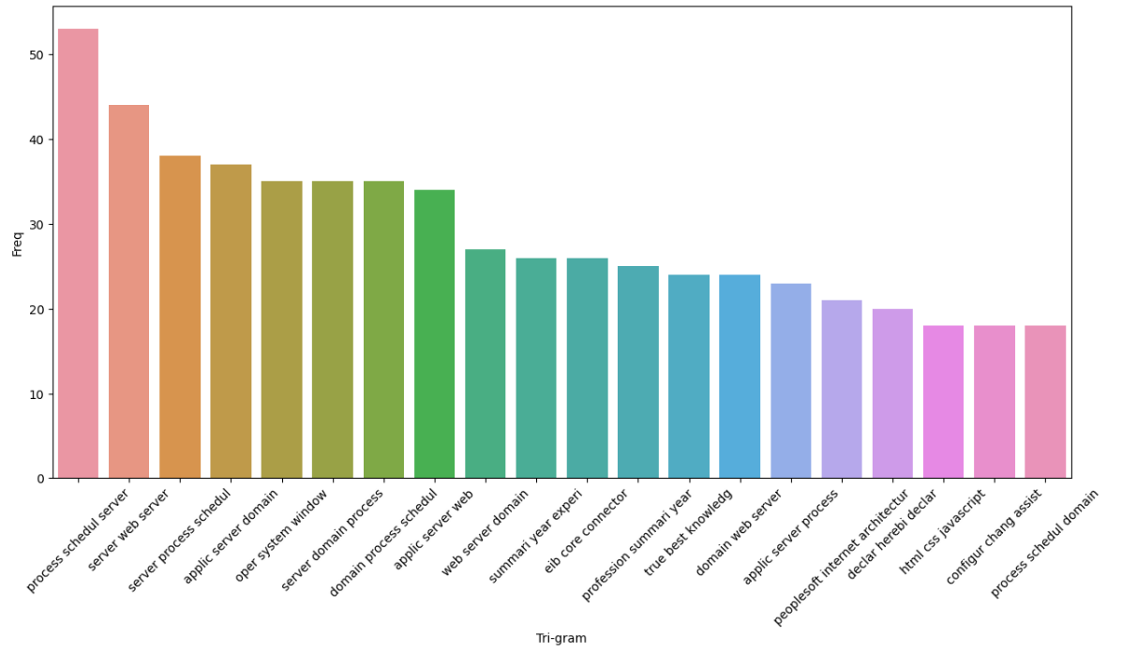
TRIGRAM WORD FREQUENCY

Slide 10
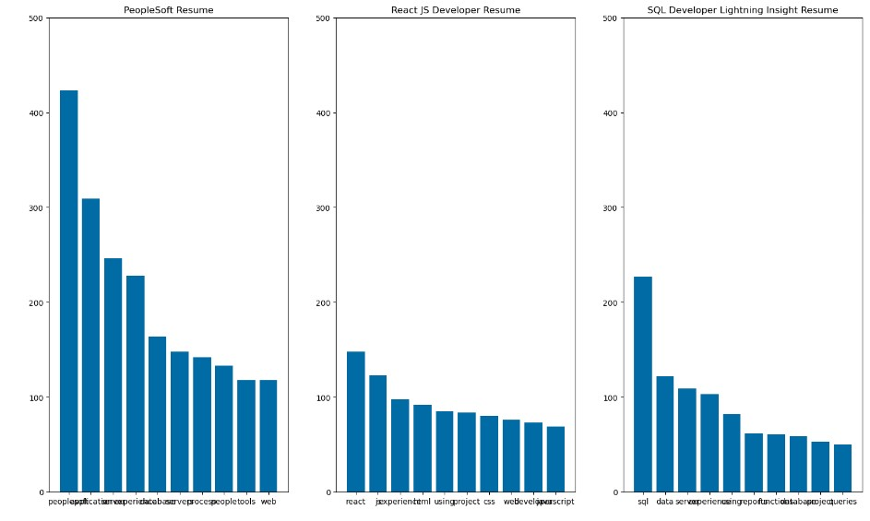
CATEGORYWISE WORD FREQUENCY

Slide 11
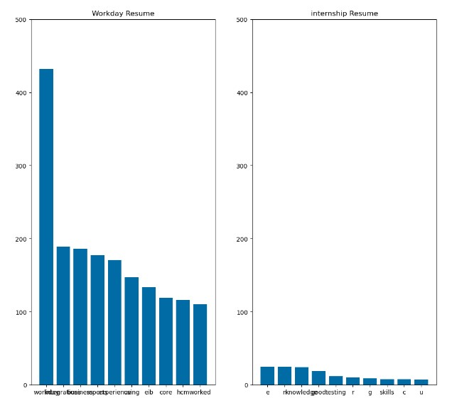
CATEGORYWISE WORD FREQUENCY

Slide 12
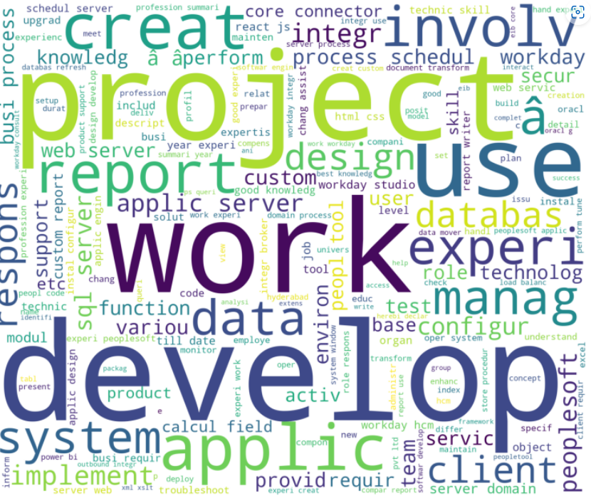
WORDCLOUD

Slide 13
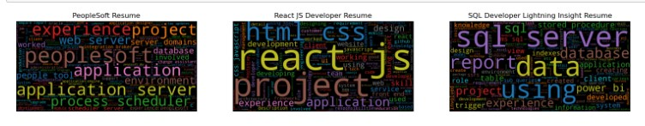

CATEGORYWISE WORDCLOUD

Slide 14
LABEL ENCODING
0 - PeopleSoft Resume
1 - React JS Developer Resume
2 - SQL Developer Lightning Insight Resume
3 - Workday Resume
4 - internship Resume

Slide 15
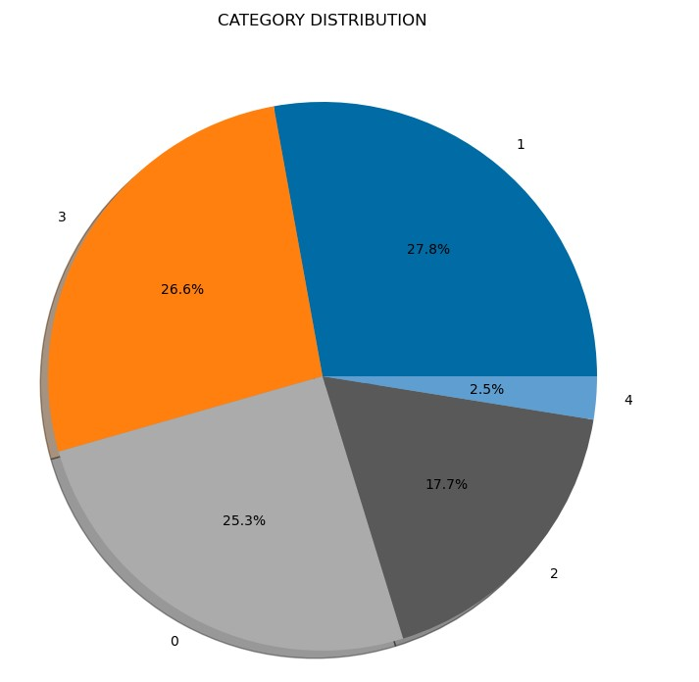
PIE CHART

Slide 16
Models
Random Forest Classifier.
SVM Classifier.
Multinomial Naïve Bayes.
Adaboost Classifier.
Gradient Boost Classifier.
XGBM and LGBM.
Decision Tree Classifier.
KNN Classifier.

Slide 17
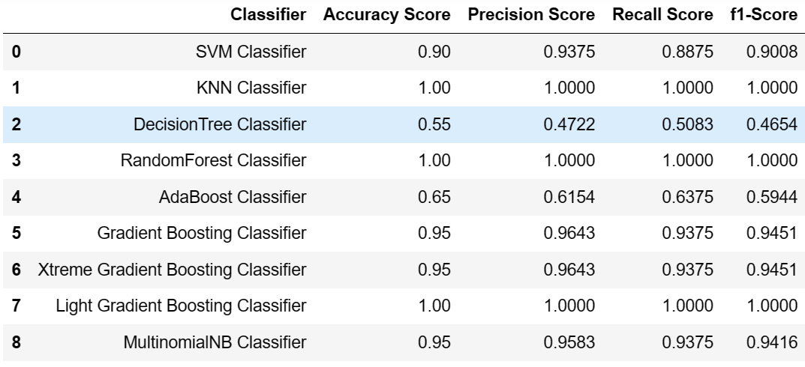
Model evaluation Metrics

Slide 18
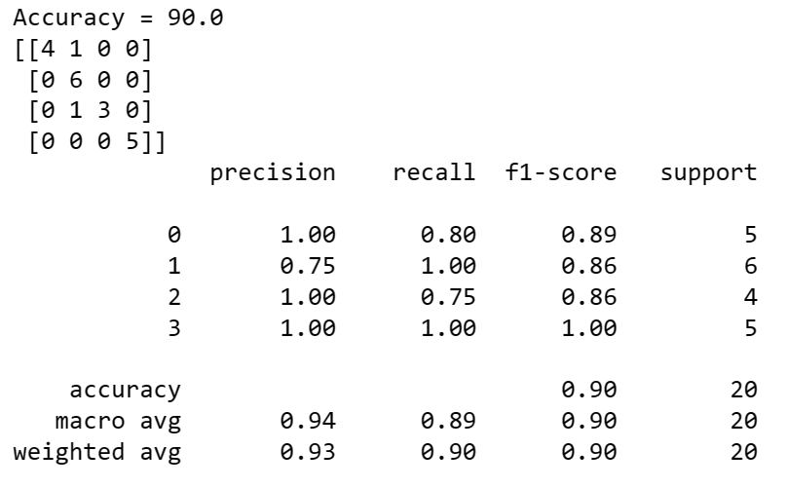
We have chose SVM(SVC) as our final model as it has the optimum TEST & TRAIN Accuracy (94/90) compared to other models which are over fitting and have less accuracy.

Slide 19
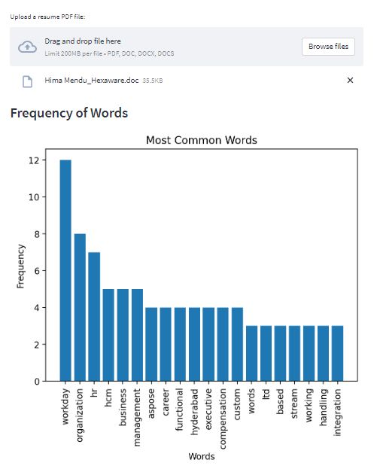
dEPLoyMENT
We used Streamlit for deployment of our model.
We used aspose-words library for extraction of words from the resumes.
We created word_vectorizer and SVM model pickle file for the deployment.

Slide 20
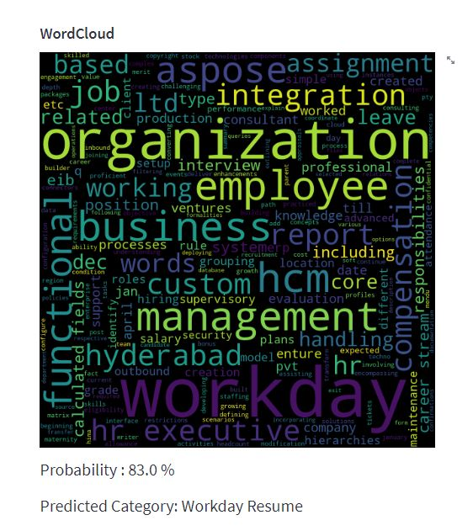
We also used word frequency graph and word cloud for better understanding of the resume.

Slide 21
Challenges
We had the problem with the types of resume files format for data extraction, then we used pdf2docx library to overcome this challenge.
We used a lot of libraries to extract texts in the deployment but was not working properly, then we found out about aspose-words library to overcome the challenge.
As the deployment took a lot of time to load the results. We used pickle files to overcome this issue.
We had error in the deployment with features, So we created a pickle file for Tfidf_vectorizer to overcome this challenge.

Slide 22
THANK YOU

